Slide 1

Session 9
Linear Programming – Transportation
Big Data and Analytics
Topic 9: Clustering
We will wait for 5 for everyone to join

Slide 2

Recap
Linear Programming – Transportation
What we discussed last week?

Slide 3
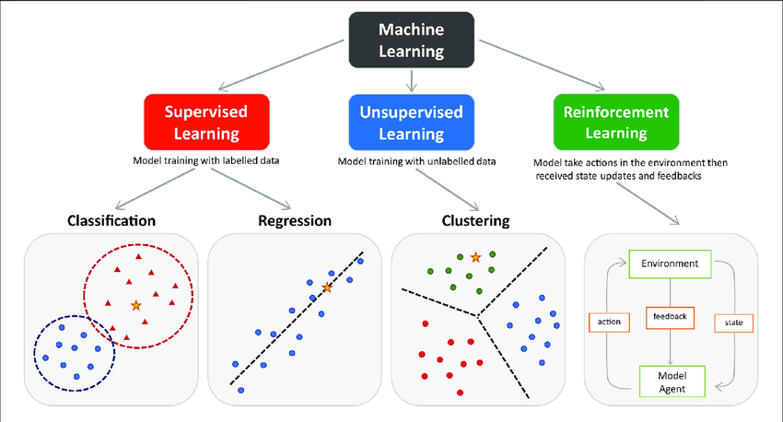
Recap: Predictive Modelling
Predictive modelling or predictive analytics: Estimates future outcomes based on historical data using statistical algorithms and machine learning (ML) techniques.
Predictive models attempt to represent the influence that a set of (independent) variables have on the outcome of another (dependent) variable of interest.
Based on this definition, on which category of ML predictive models can be applied?
Notes:
Regression: Predicting continuous values, such as the price of a house or stock, or temperature forecasts.
Classification: Predicting discrete outcomes, such as whether an email is spam or not, or if a credit card transaction is fraudulent.
While predictive modelling is most closely aligned with supervised learning, there are aspects of it that can be related to other types of machine learning:
In unsupervised learning, predictive modelling could be used for anomaly detection where the model predicts which instances in new data don't fit the pattern of the training data.
In reinforcement learning, predictive models can be used to estimate the future rewards for different actions, even though the primary goal is not prediction but rather to learn a policy of actions.

Slide 4
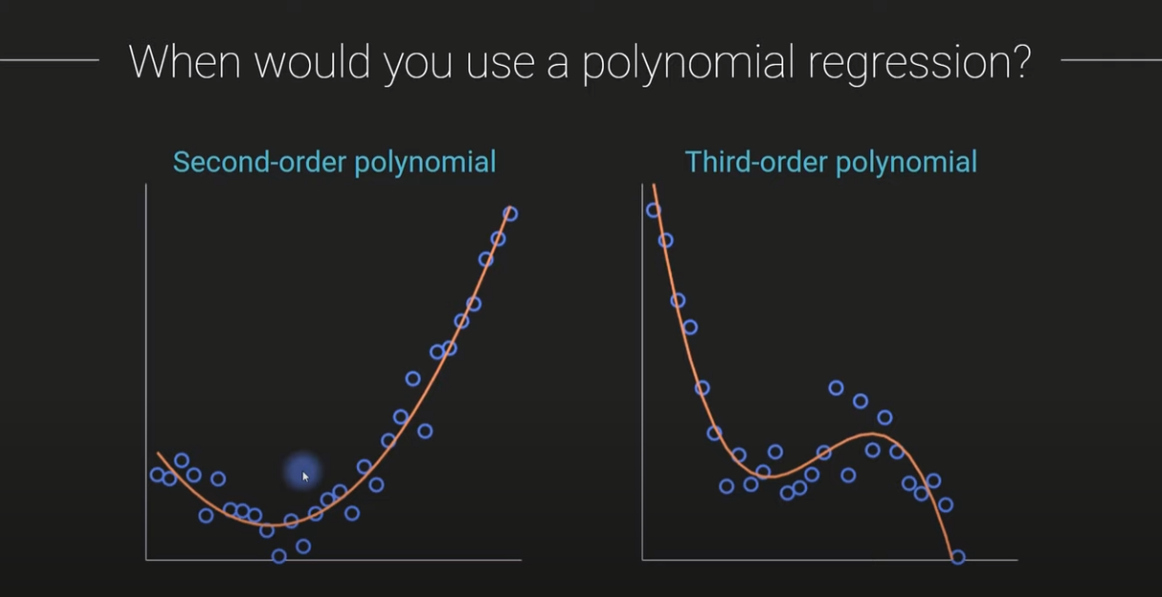
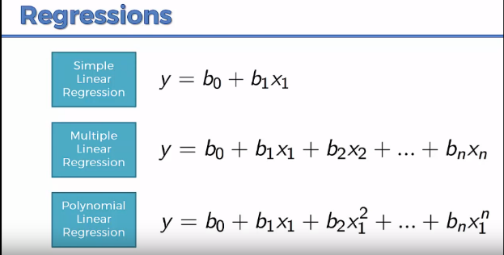
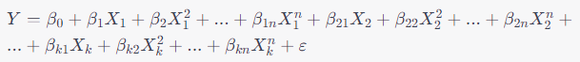
Recap: Predictive Modelling
multiple polynomial regression models
It helps capture Non-linear relation between dependent and independent variables.
Notes:
multiple polynomial regression models that capture the relationship between one independent variable and two or more independent variables using n-th degree polynomials

Slide 5
Introduction to Clustering
Imagine sorting your wardrobe:
You could group cloths by:
Color (all blacks together)
Type (shirts, dresses, skirts, jackets)
Season (summer, winter)
That’s clustering – grouping similar items.
That’s unsupervised – no told you how, you figured it out yourself

Slide 6
Clustering
Group these items:
Apple, banana, cat, lion tiger, phone, orange, brocoli, carrot, mouse, printer, spinach
How do you group them? Why?
Apple | brocoli | cat | mouse
banana | carrot | lion | printer
orange | spinach | tiger | phone

Slide 7
Clustering
Definition:
Clustering refers to the tasks of grouping data and creating partitions between those groups based on similarities.
Why cluster analysis?
Clustering allows us to navigate the vastness of unlabelled data, identifying groups and patterns that lead to deeper insights.
Labelling is expensive
Based on this definition, could you tell us does
the clustering belong to which category of
machine learning? Why?
Unsupervised – we don’t tell the algorithm what the groups are – it finds them by itself!

Slide 8
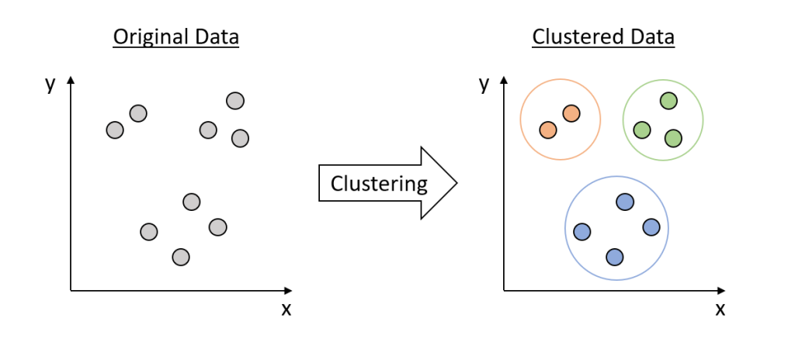
Clustering
Notes:
Image source:https://waterprogramming.wordpress.com/2022/03/16/clustering-basics-and-a-demonstration-in-clustering-infrastructure-pathways/

Slide 9
Clustering
How it works:
You give the algorithm data points (no labels!).
It groups those points into clusters based on how similar they are.
Each cluster contains data points that are more similar to each other than to points in other clusters.
Real time examples (simple)
Food delivery app – Groups customers by order habits. Can be used for targeted promotions
Online shopping – Groups based on browsing or buying behaviour. Helps personalize
recommendations.
Music Streaming – Groups songs by audio features to auto generate playlist

Slide 10
Clustering
Clustering Applications
Marketing - Customer Segmentation
Segmenting customers based on various attributes, leading to more personalized marketing efforts.
Biology - Understanding Biodiversity
To classify species and understand genetic relationships
Social Network Analysis - Community Detection
To detect communities within social networks
Image Processing - Pattern Recognition
Segmenting images into meaningful components, aiding in various advanced image processing tasks

Slide 11
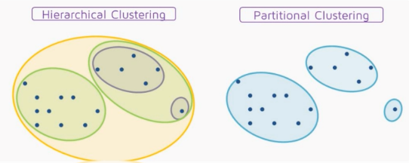
Clustering
Partitional Clustering
Nonhierarchical, each instance is placed in exactly one of K non-overlapping clusters.
Since only one set of clusters is output, the user normally has to input the desired number of clusters K.
Hierarchal Clustering Methods Summary
No need to specify the number of clusters in advance
Hierarchal nature maps nicely onto human intuition for some domains
They do not scale well: time complexity of at least O(n²), where n is the number of total objects
Like any heuristic search algorithms, local optima are a problem
Interpretation of results is (very) subjective

Slide 12
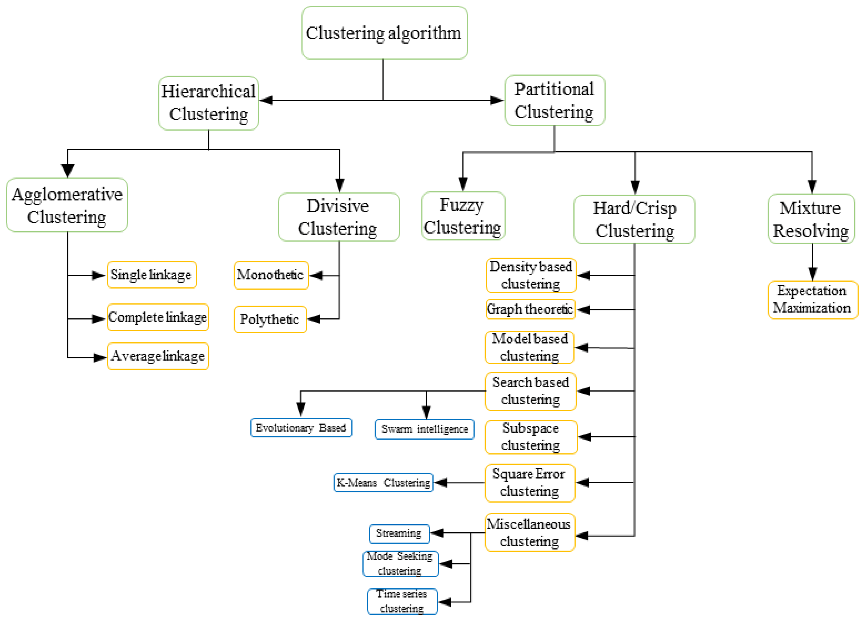
Clustering Methods
Notes:
Image source: https://doi.org/10.3390/app13063529
Hierarchical clustering is a method of grouping data into a tree-like structure of clusters, called a dendrogram.
Think of it like organizing files into folders → subfolders → sub-subfolders.
1. Agglomerative (Bottom-Up) (Most common)
Start with each data point as its own cluster
Gradually merge the closest clusters
Continue until everything is merged into one big cluster
2. Divisive (Top-Down)
Start with all data in one big cluster
Split it into smaller and smaller clusters

Slide 13
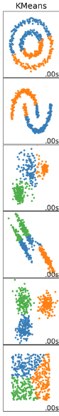
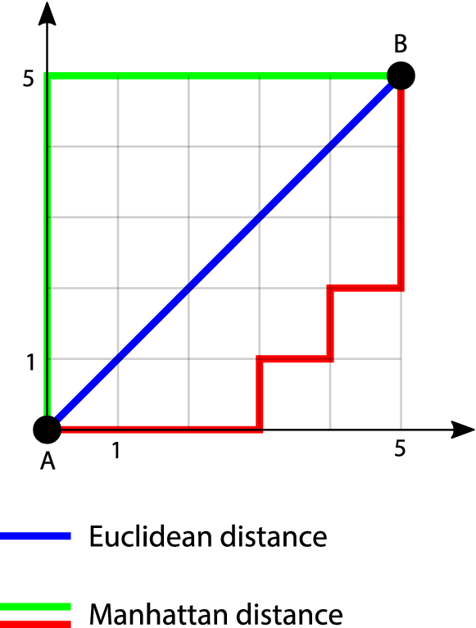
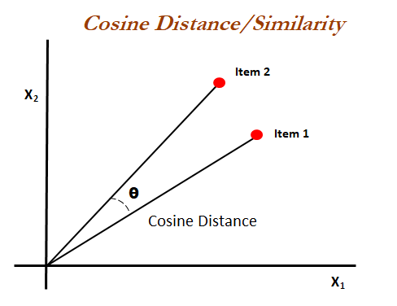
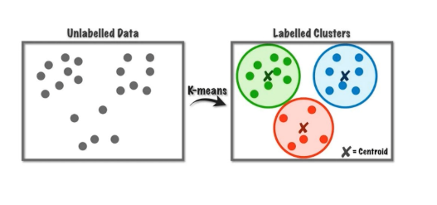
Clustering Methods
Clustering Methods in Machine Learning
Distance-Based Methods
These include algorithms like KMeans and hierarchical clustering.
They rely heavily on distance metrics (like Euclidean, Manhattan, or cosine similarity) to form clusters.
The basic principle is that points closer to each other are more similar and thus should be in the same cluster.
Notes:
Image source: https://scikit-learn.org/stable/modules/clustering.html

Slide 14
Clustering
K-means Clustering: Initialisation Step: Decide on a value for K
k = 1, the objective function is 873.0
k = 2, the objective function is 173.1
k = 3, the objective function is 133.6
1
2
3
4
5
6
7
8
9
10
1
2
3
4
5
6
7
8
9
10
1
2
3
4
5
6
7
8
9
10
Notes:
In clustering, objective function could be sum of variation in each cluster or evaluation metrics
https://www.youtube.com/watch?v=GZj6ikx8PAc

Slide 15
Clustering
We can plot the objective function values for k equals 1 to 6…
The abrupt change at k = 3, is highly suggestive of three clusters in the data. This technique for determining the number of clusters is known as “knee finding” or “elbow finding”.
1.00E+03
9.00E+02
8.00E+02
7.00E+02
6.00E+02
Objective Function
5.00E+02
4.00E+02
3.00E+02
2.00E+02
1.00E+02
k
0.00E+00
1
2
3
4
5
6

Slide 16
Clustering
K-means Clustering: Step 1
5
1. Initialize the k cluster centers (randomly, if necessary).
4
k₁
3
k₂
2
1
k₃
0
0
1
2
3
4
5
Notes:
Step 1: Select the number of cluster you want to identify in your data. This is “K” in K-means clustering.

Slide 17
Clustering
K-means Clustering: Step 2
5
2. Decide the class memberships of the N objects by assigning them to the nearest cluster center.
4
k₁
3
k₂
2
1
k₃
0
0
1
2
3
4
5

Slide 18
Clustering
K-means Clustering: Step 3
5
4
3. Re-estimate the k cluster centers, by assuming the memberships found in step 2 are correct.
k₁
3
2
k₃
k₂
1
0
0
1
2
3
4
5

Slide 19
Clustering
K-means Clustering: Step 4
5
4
k₁
If none of the N objects changed membership in the last iteration, exit. Otherwise go to Step 3,
Re-estimate the k cluster centers.
3
2
k₃
k₂
1
0
0
1
2
3
4
5

Slide 20
Clustering
K-means Clustering: Step 5
k₁
If none of the N objects changed membership in the last iteration, exit.
k₂
k₃

Slide 21
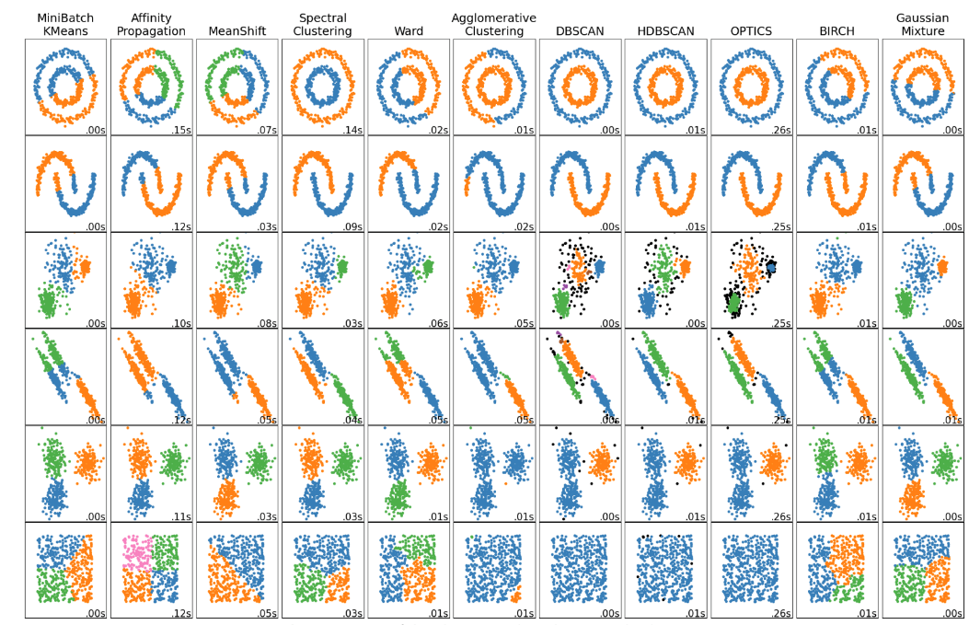

Clustering Methods
Clustering Methods in Machine Learning
2. Density-Based Methods
Algorithms like DBSCAN (Density-Based Spatial Clustering of Applications with Noise) and OPTICS (Ordering Points To Identify the Clustering Structure)
These methods define clusters as dense regions of data points in the data space, separated by regions of lower density.
They are particularly good at identifying clusters of arbitrary shapes and sizes and can handle noise and outliers effectively.
Notes:
Image source: https://scikit-learn.org/stable/modules/clustering.html

Slide 22


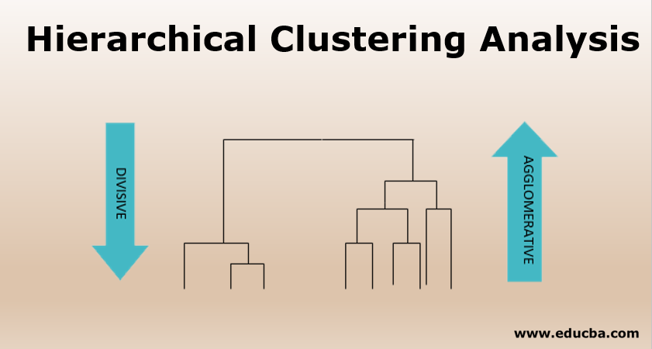
Clustering Methods
Clustering Methods in Machine Learning
3. Connectivity-Based Methods (Hierarchical)
Hierarchical clustering builds models based on distance connectivity.
It creates a tree of clusters and doesn't require specifying the number of clusters beforehand.
There are two types: agglomerative (bottom-up approach) and divisive (top-down approach).
Dendrogram is a tree-like diagram that records the sequences of merges or splits
Notes:
Image source: https://scikit-learn.org/stable/modules/clustering.html

Slide 23
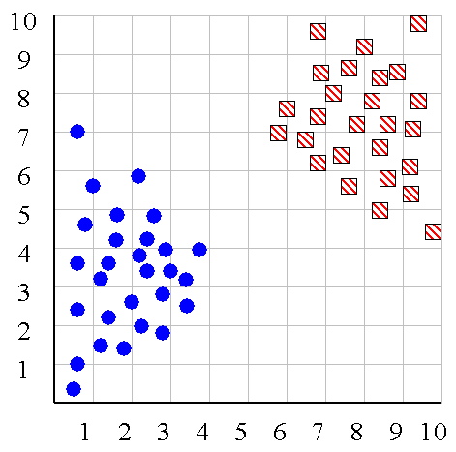
Clustering
Hierarchal Clustering
Agglomerative starts with each point as a separate cluster and merges them, while divisive starts with one cluster and splits it iteratively.
Linkage Criteria: how to define the distance between two clusters
Single Linkage (MIN linkage),
Complete Linkage (MAX linkage),
Average Linkage (AVG linkage),
Ward Linkage

Slide 24
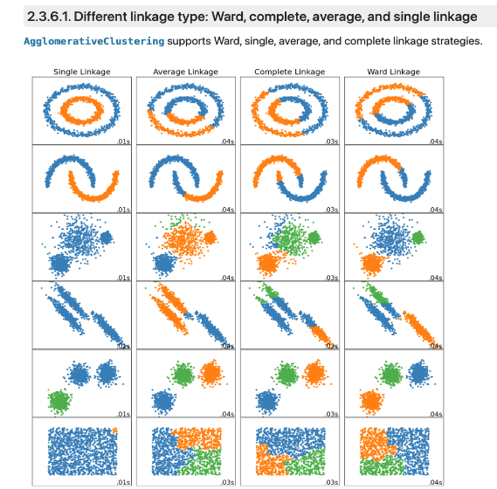
Clustering
Linkage Criteria: how to define the distance between two clusters
Single Linkage (MIN linkage),
Complete Linkage (MAX linkage),
Average Linkage (AVG linkage), etc
Notes:
Image source: https://scikit-learn.org/stable/modules/clustering.html

Slide 25
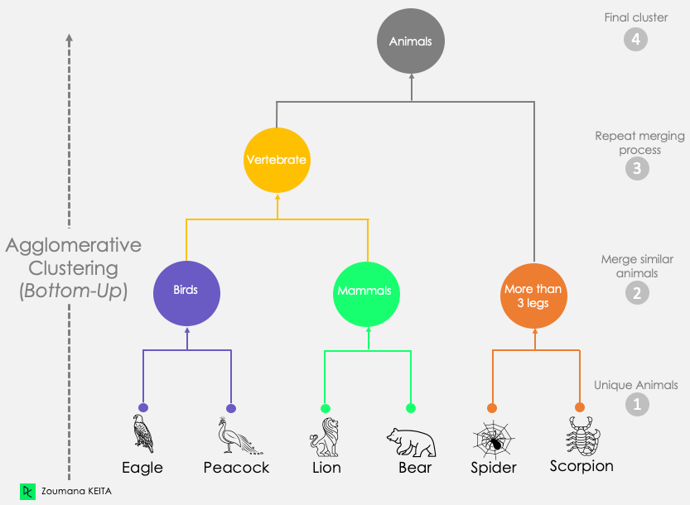
Clustering Methods
Notes:
Image source: https://www.datacamp.com/tutorial/introduction-hierarchical-clustering-python

Slide 26
Clustering Methods
Remember to watch this video later for a clearer and more comprehensive understanding of Hierarchical Clustering. https://www.youtube.com/watch?v=8QCBl-xdeZI&t=3s
Notes:
Image source: https://www.datacamp.com/tutorial/introduction-hierarchical-clustering-python

Slide 27
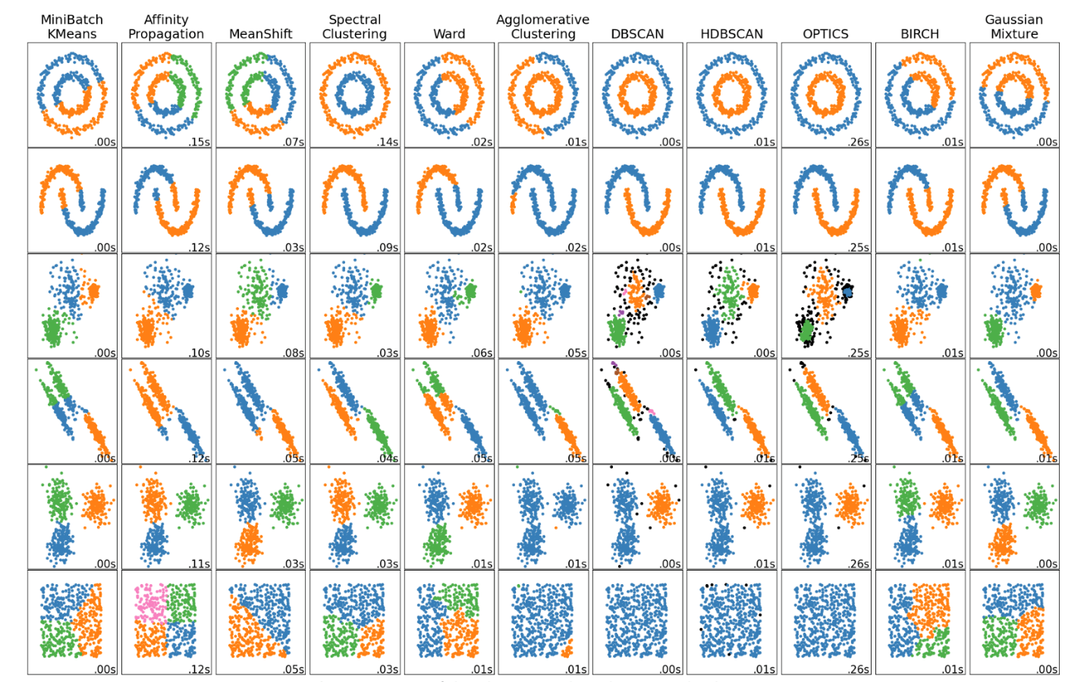

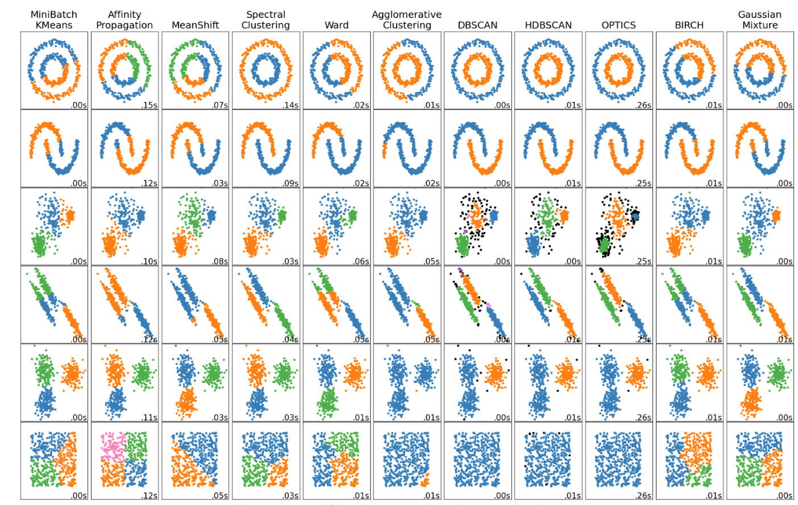
Clustering Methods
Clustering Methods in Machine Learning
4. Distribution-Based Methods
These methods, such as Gaussian Mixture Models, assume that the data points are generated from a mixture of several distributions (like Gaussian distributions).
The goal is to identify these distributions and their parameters, which inherently define the clusters.
These methods are powerful in capturing more complex cluster structures.
Notes:
Image source: https://scikit-learn.org/stable/modules/clustering.html

Slide 28
Clustering Methods
5. Model-Based Methods:
These methods hypothesize a model for each cluster and try to find the best fit of the data to the given model. A well-known example is Expectation-Maximization (EM) clustering using Gaussian Mixture Models.
6. Feature-Based or Conceptual Methods:
These methods form clusters based on the concept of features that define the cluster. For example, clustering based on frequent itemsets in data mining is a feature-based method.
7. Graph-Based Methods:
In these methods, data is represented as a graph, and clustering is performed based on graph theoretic properties. The Spectral Clustering algorithm is a notable example, which uses the eigenvalues of a matrix derived from the graph to perform dimensionality reduction before clustering in fewer dimensions.

Slide 29
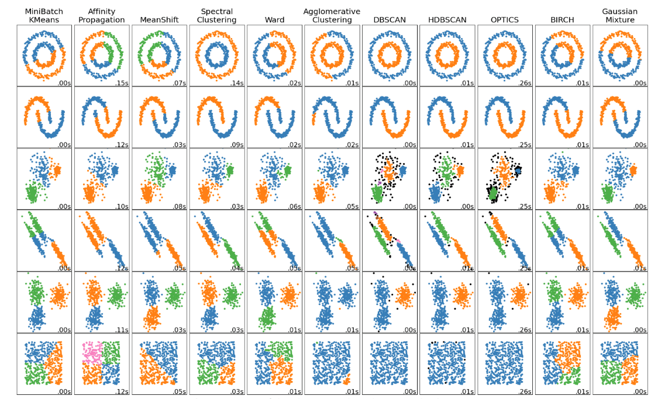
Clustering Methods
Notes:
Image source: https://scikit-learn.org/stable/modules/clustering.html

Slide 30
Clustering
The Four Steps of Cluster Analysis
Feature Selection or Extraction
identifying the most relevant attributes of data
Filter Methods (e.g., Chi-squared test, Information Gain)
Wrapper Methods (e.g., Recursive Feature Elimination)
Embedded Methods (e.g., LASSO, Decision Trees)
Dimensionality Reduction (e.g., PCA)
Clustering Algorithm Design or Selection
Partitional algorithms: Construct various partitions and then evaluate them by some criterion
Hierarchical algorithms: Create a hierarchical decomposition of the set of objects using some criterion
Cluster Validation
Evaluation Metrics: Silhouette Coefficient, Davies-Bouldin Index
Results Interpretation
Understanding and Making Sense of Clusters
Practical Implications of Cluster Analysis
Visualization Techniques

Slide 31
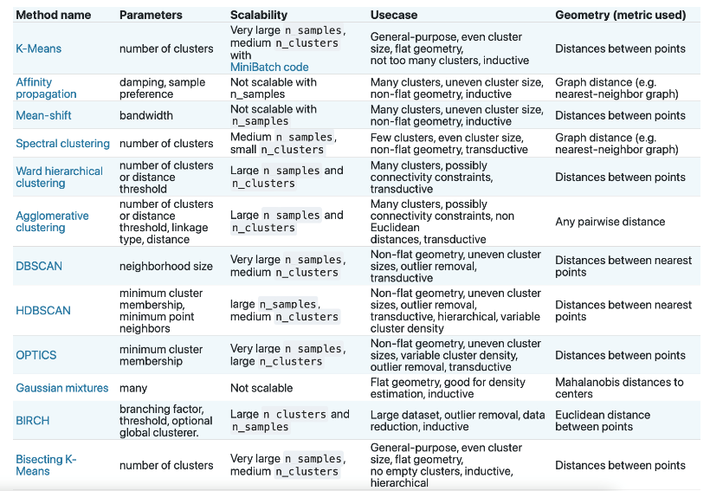
Clustering
Clustering Methods
in Scikit-learn library of Python

Slide 32
Questions?

